Slide 1


Welcome
Connect User Manual
License No: SECP/LRD/41/TFCL/2022, Status: Active

Slide 2

CONTENTS OF THIS APPLICATION
Introduction
How to Install
Getting Started
Account Creation
Loan Application Process
Repayment Process
Account Management
FAQs

Slide 3

How to Install
  Open the Google Play store on your device and Use the search bar to find the Taleem Connect application.
  Tap on the Taleem Connect app icon.
  Click on the "Download" or "Install" button to initiate the download process.
  Once the download is complete, the app will automatically install on your device.
  Locate the Taleem Connect app icon on your device's home screen or app drawer.
  Tap on the icon to launch the application.
  If you're a new user, sign up for an account. If you're an existing user, log in with your credentials.
  Visit this Website For further details www.taleemfinance.com
  Taleem Connect App is hosted only at the Google Play Store and shall not be hosted or downloaded from any other third-party websites/ App Platforms.

Slide 4
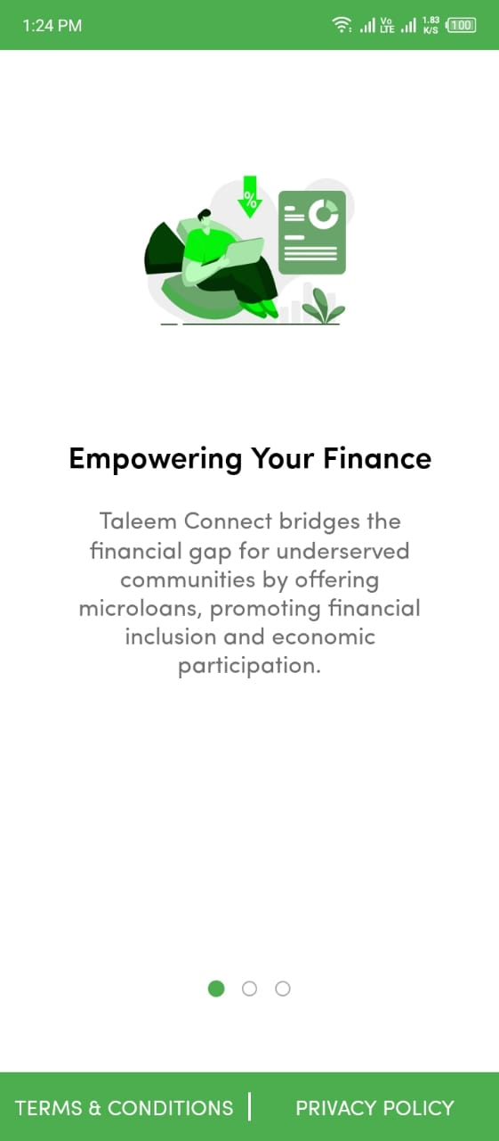
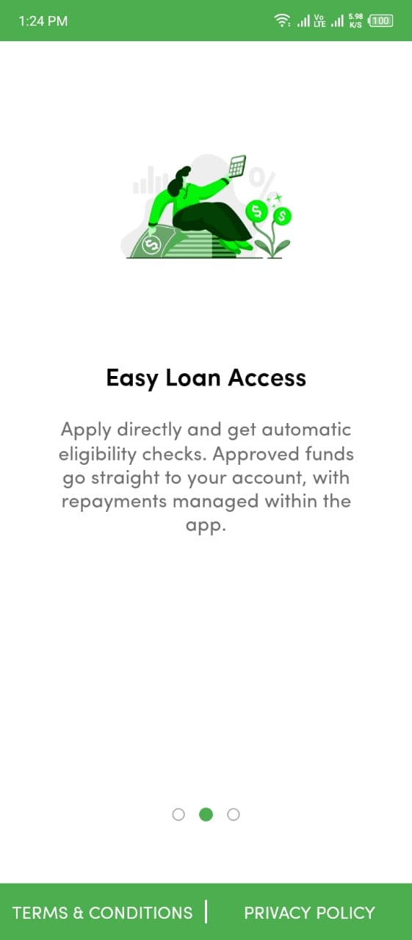
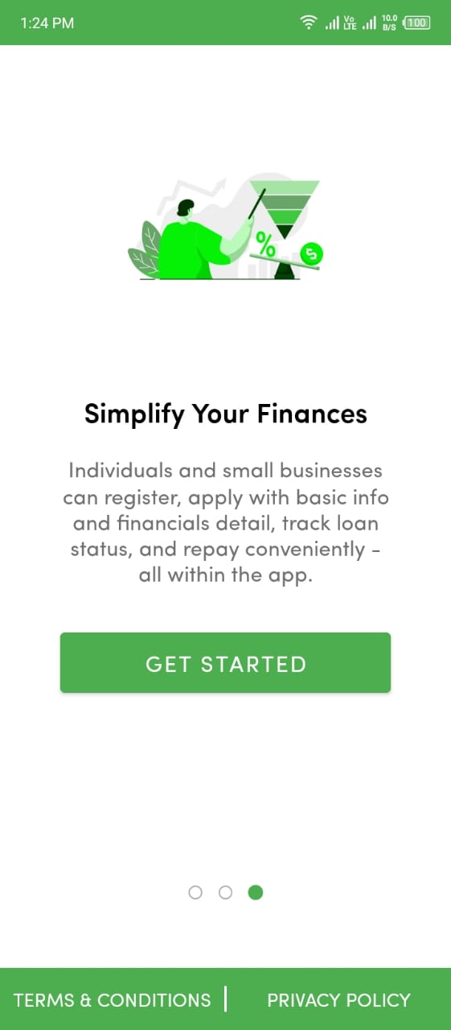
Introduction
1
Click Get Started Button for moving Sign-Up/ Sign-In
You can give here a brief description of the topic you want to talk about. For example, if you want to talk about Mercury, you can say that it’s the smallest planet in the entire Solar System
1

Slide 5
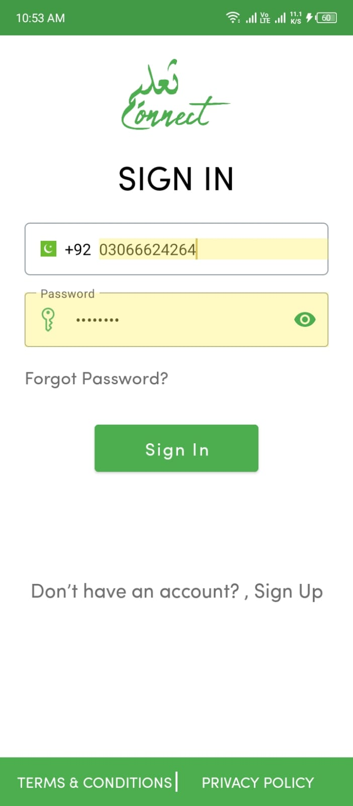
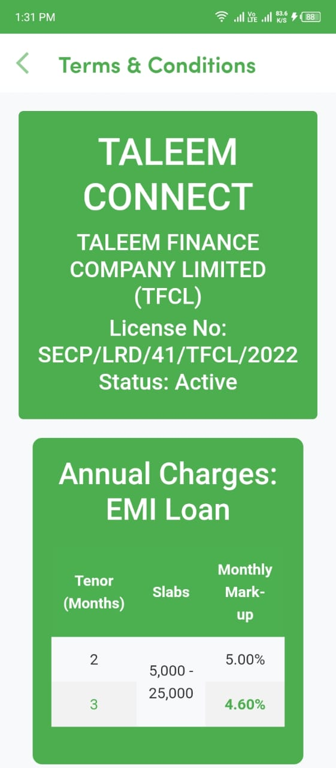
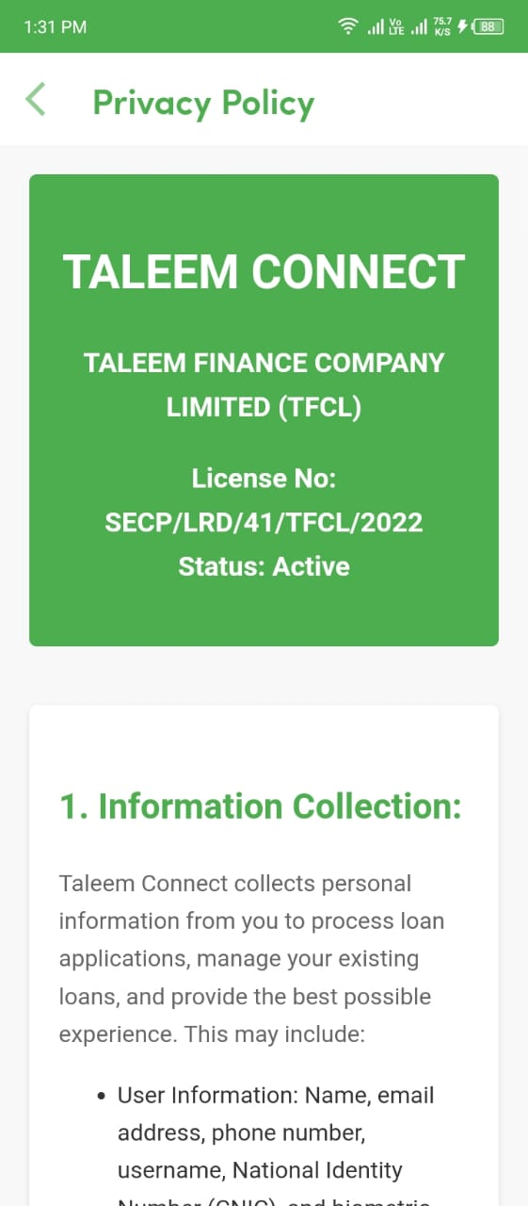
Terms & Conditions
Privacy Policy
Please read carefully our Terms & Conditions and Privacy Policy for important information regarding your rights and responsibilities
1
2
1
2

Slide 6
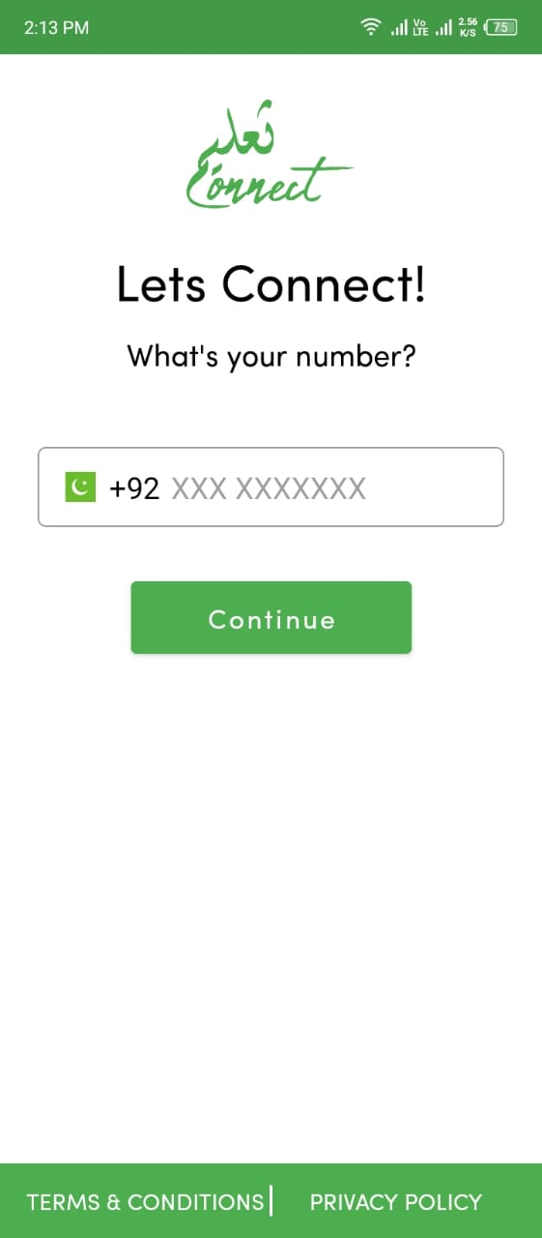
Sign In Page
IMMY JIMMY
SUSAN BONES
Enter Number
Enter Password
Forgot Password if you not know
Click for Sign In
if you don’t have an account then sign up
Read Term & Conditions
Check Privacy Policy
Enter Your Phone Number
Click Continue For Sign Up
1
1
2
3
2
1
2
1
3
4
2
4
5
5
6
USERNAME
PASSWORD
LOGIN
6
7
7

Slide 7
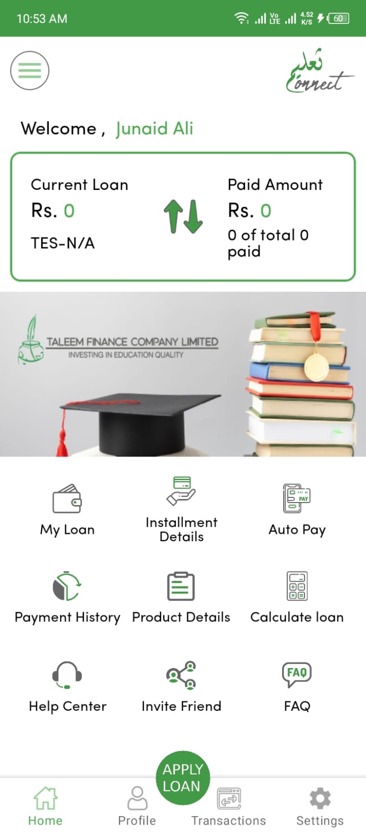
1 : Current Loan And Paid Amount
2 : You can see your loans how much loan are pending
3 : Check current Installment Details
4 : Coming Soon Not implement yet
5 : Check your loan payment History
6 : Check All the Products Details
8 : You can easily calculate your Loan Amount
9 : If you suffering some issues or problem you can use Help Us
0 : You can easily invite your friends
Dashboard Screen
1
1
2
3
4
5
2
3
4
6
5
6
7
7
8
9
0
8
0

Slide 8
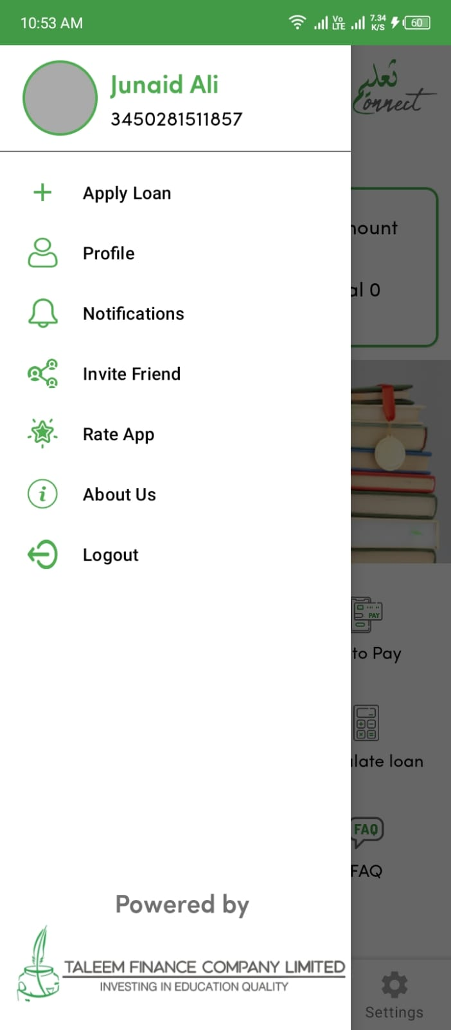
1 : Apply for loan click here
2 : if you want to see your profile click here
3 : for watching notification click here
4 : if you want to invite your friends click here
5 :You can rate the app for click here
6 : Check About Us Taleem Connect Application
7 :If you want to logout or open another account click here
Drawer Menu
1
1
2
2
3
3
4
5
4
6
7
5
6
7

Slide 9
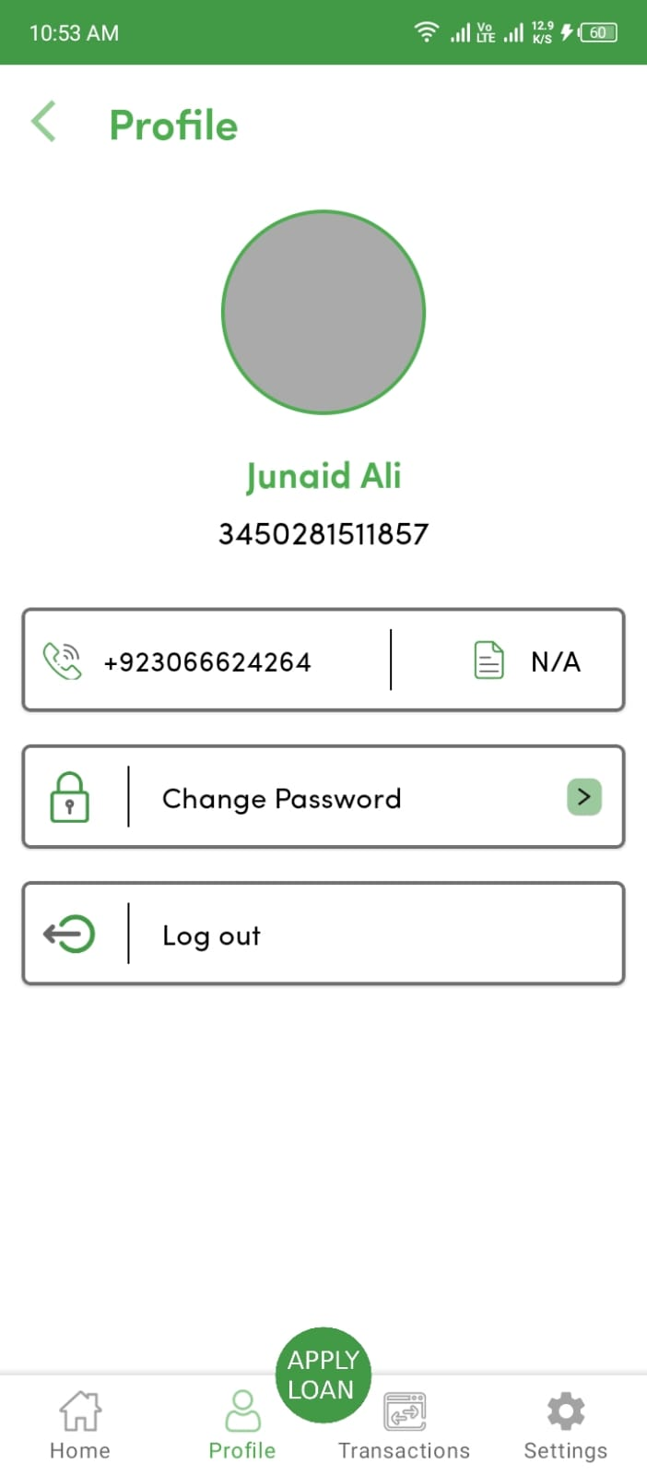
a
Home Screen Features
1: Your Profile Image , Name and CNIC here
2: Your Mobile number which mobile number you are created
Account
3: If you ant to change your password click here
4: If you want to logout your current account click here
5: If you want to apply for new loan click here
1
1
2
2
3
4
3
4
5
5

Slide 10
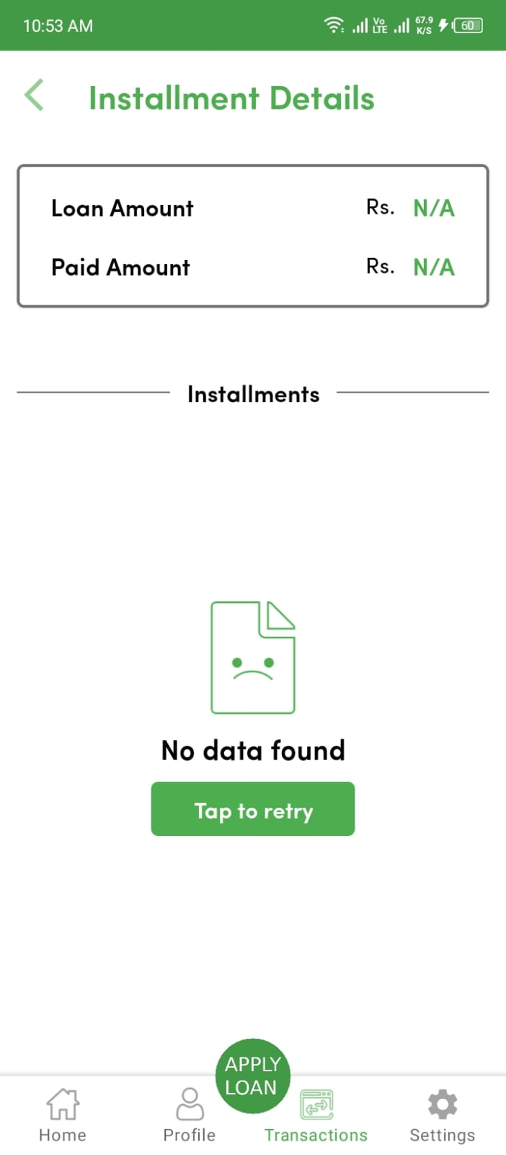
Installment Details
1 : Your Current Loan and your Paid loan is here
2 : Your pending and paid Installment here
1
1
2
2

Slide 11
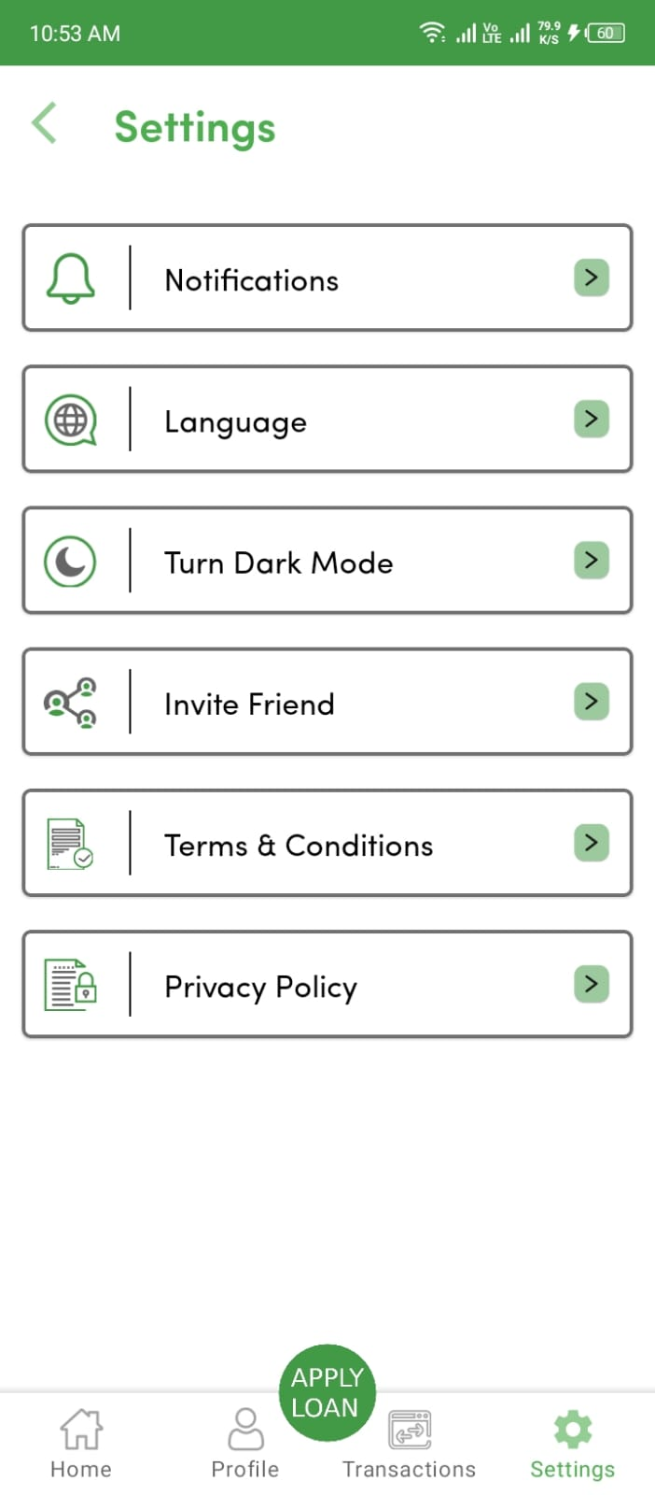
Settings
1 : Show latest notification here
2 : Your can choose and convert language English to Urdu and Urdu to English
3 : Convert Light And Dark Mode here
4 : If you want to invite your Friends click here
5 : Check Terms And Conditions Of Taleem Connect Application
6 : Read Privacy And Policy of Taleem Connect
1
1
2
2
3
4
5
3
6
4
5
6

Slide 12
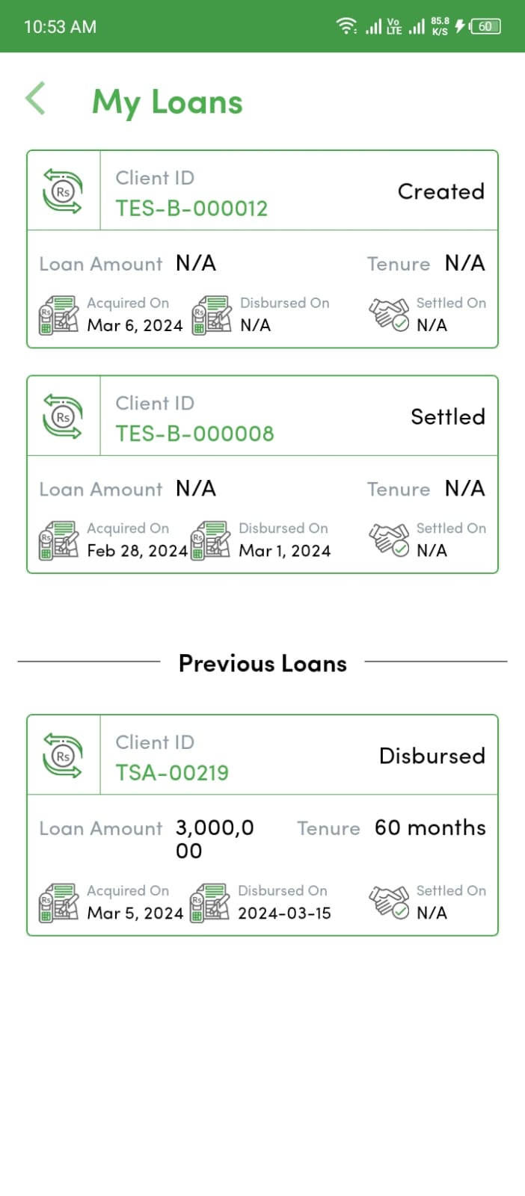
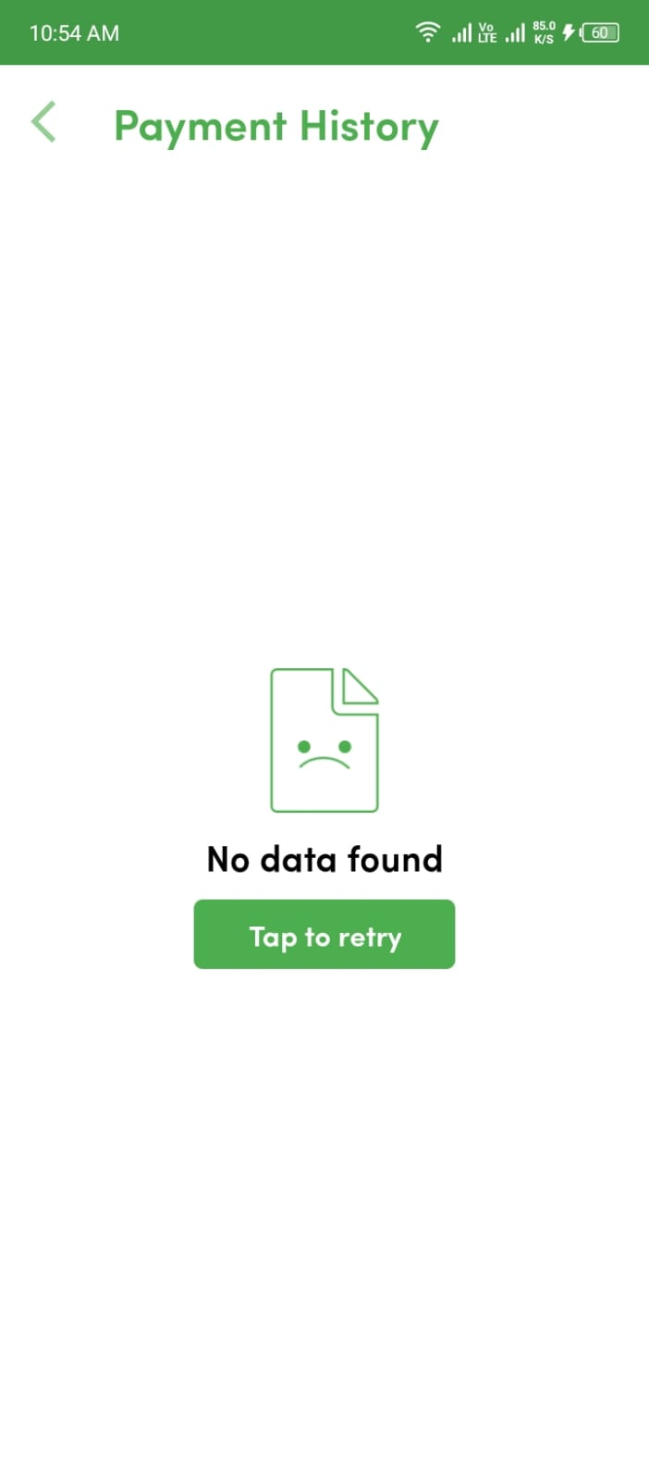
h
h
My Loans
Payment History
1 : Show latest notification here
2 : Your can choose and convert language English to Urdu and Urdu to English
3 : Convert Light And Dark Mode here
4 : If you want to see your payment history, please click on “Tap Button”
1
4
4
1
2
2
3
3

Slide 13
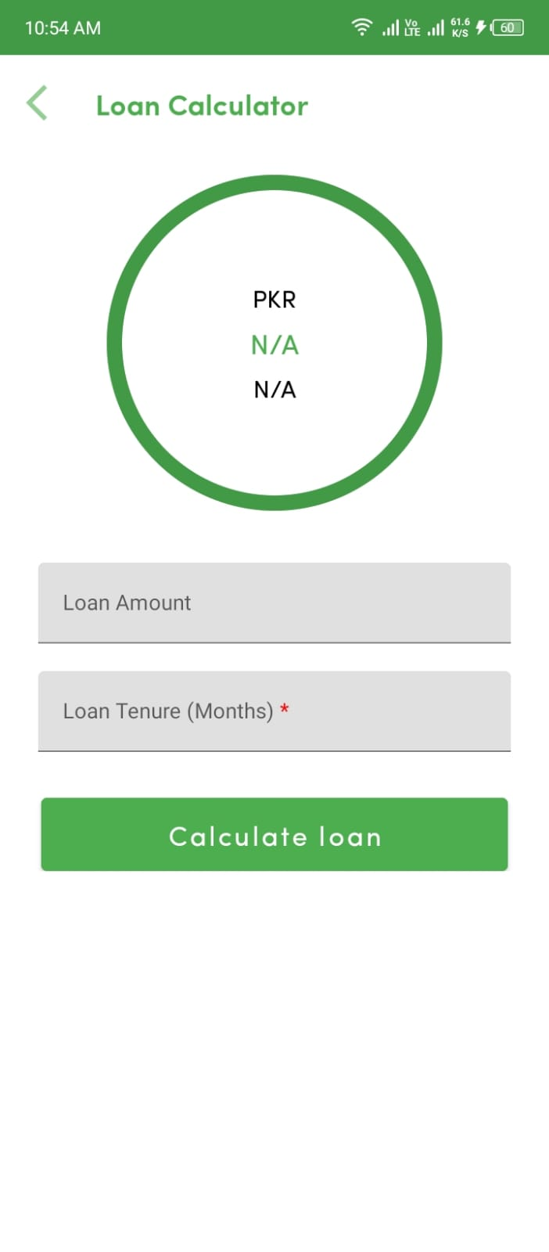
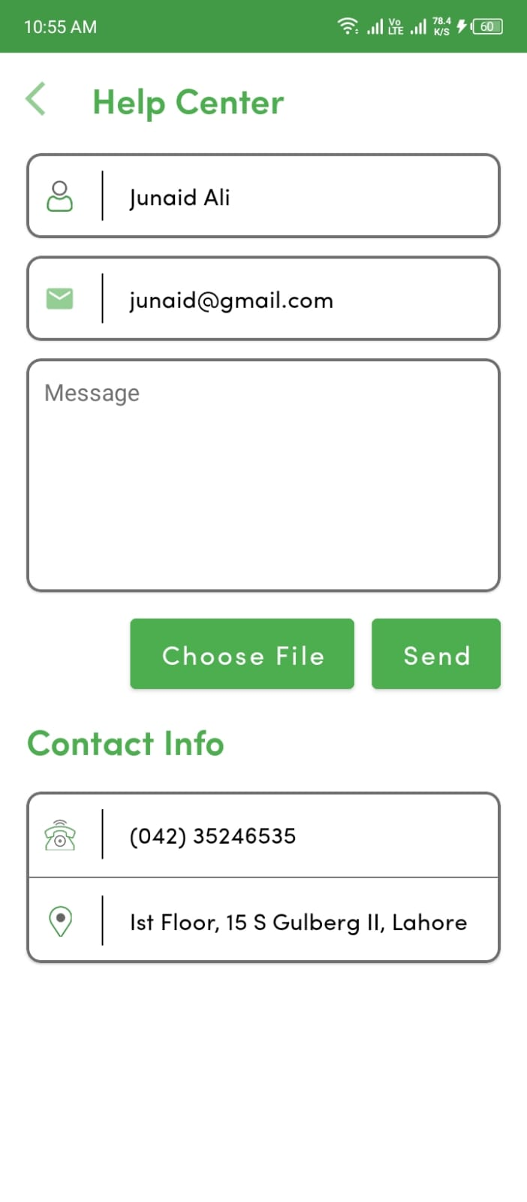
Loan Calculator
Loan Calculator
1 : Calculation Amount is here
2 : Enter Your Loan Amount
3 : Enter Your Tenure Month
3 : Click here for Calculate loan
1 : User Name
2 : User Email
3 : If you are suffer in some issue or problem type your text and click send
3 : Company address and Contact Number
1
1
1
1
2
2
2
3
3
2
3
3
4
4
4
4

Slide 14
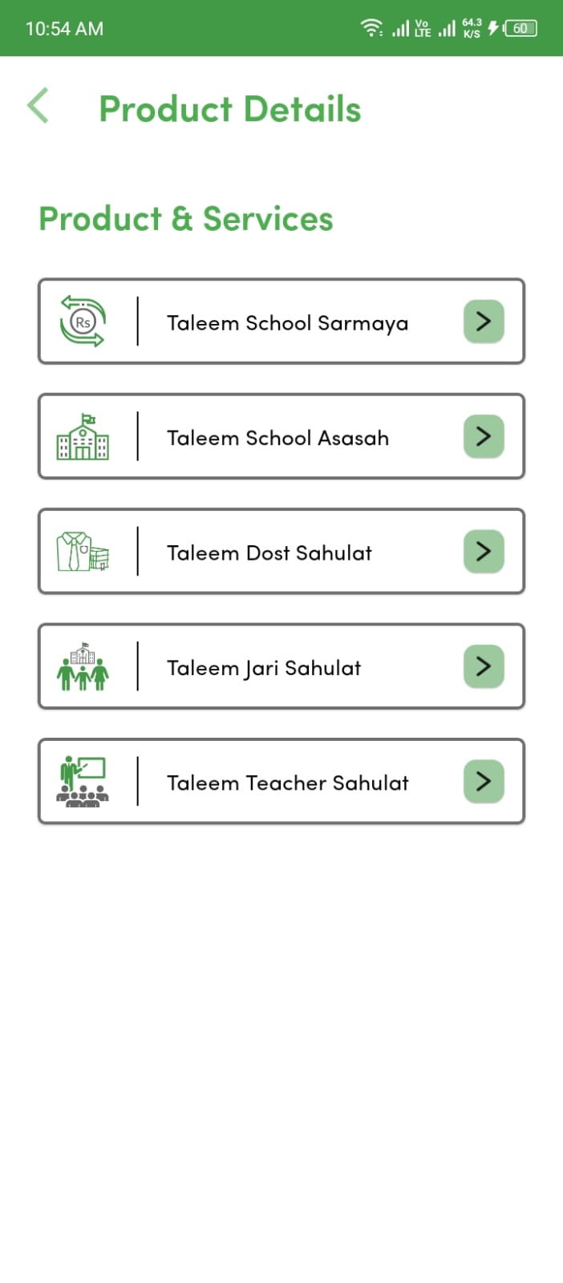
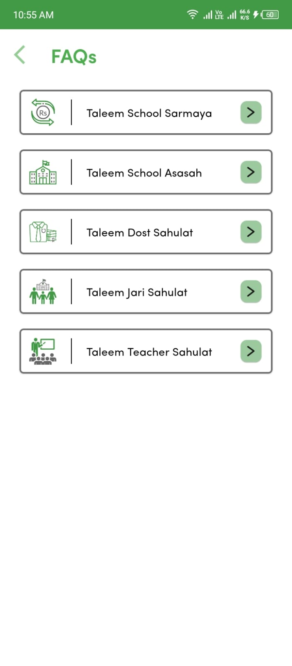
Product Details
FAQ’s
1 : Taleem Connect All Products and Services
is here you can choose And read before applying for loans
LOGIN
NEW ACCOUNT

Slide 15
APP LOGO
Taleem Connect Micro Loan: Empowering education through accessible financing for bridging the gap between financial constraints and educational aspirations.

Slide 16
다
Thanks
음
Do you have any questions?
info@taleemfinance.com
+92 423 5246536 – 7
www.taleemfinance.com
https://www.facebook.com/TFCLPakistan/
https://www.linkedin.com/company/taleem-finance-company-ltd/?originalSubdomain=pk

